Slide 1


Prepared by:
Information Technology-Semester 5
Emoji
Prediction
Krupali Dobariya(18DIT014)
Priyal Ramani(D19DIT082)
GUIDE:
-Mr. Dipak Ramoliya

Slide 2
Contents
Introduction
Current System and its limitations
Scope of the System
Tools and Technology
Hardware and Software Requirements
Project Definition
Snapshots
Flowchart
Learning Outcomes
References

Slide 3
Introduction
Emojis are the incredible way of expressing yourself. Therefore, our machines should also be aware of the appropriate emoji to be used at the right time.
In this project, the model is predicting emoji's according to a given sentences using models.
The goal of this project is to predict an emoji that is associated with a text message.

Slide 4

Current system and its limitations
Less Accurate.
Limited Feature.
Time consuming.
No future prediction.

Slide 5
Scope
Efficient prediction.
Reduced time consumption.
Accurate result.
Various ways to predict.
Various ways to see human Emotions using Emoji.

Slide 6
Tools and Technology
Python.
Jupyter notebook.

Slide 7
Hardware and Software Requirement
Minimum Hardware Requirement:
Intel(R)core(TM) i3-3200.
2GB of RAM memory.
1GB of Secondary storage.
Minimum Software Requirement:
Operating System: Windows 7 or higher, Linux.
Development language: Python
Interpreter: Python IDLE(3.7), Jupyter Notebook.

Slide 8
Project Definition
Give accurate dataset.
Pandas -
Pre-processing: Format data for pre-processing.
: Removal of null values, Filling of incomplete data.
Matplotlib -
Data visualisation: Meaningful visualisation using graph like bar, chart, scatter.

Slide 9
Project Definition
Numpy -
Data manipulation : Easy and efficient data calculation within dataset
Emoji-
-Predict Emoji from Sentence and Emotions.
Keras-
-For Training data and predict the data using LSTM model.
Create model using LSTM for emoji prediction from statements.

Slide 10
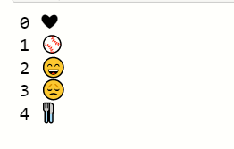
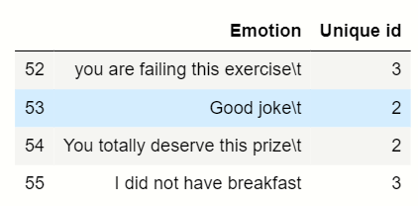
Snapshots
Emoji from unique value dataset

Slide 11
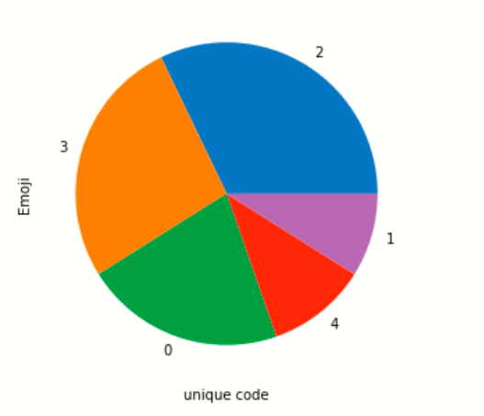

Snapshots
Data visualization
Accuracy

Slide 12
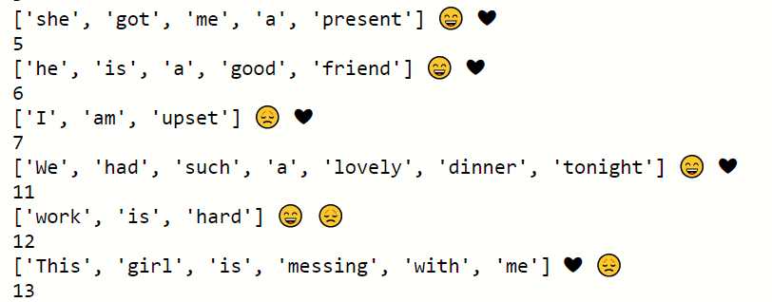
Snapshot
Predicted data

Slide 13
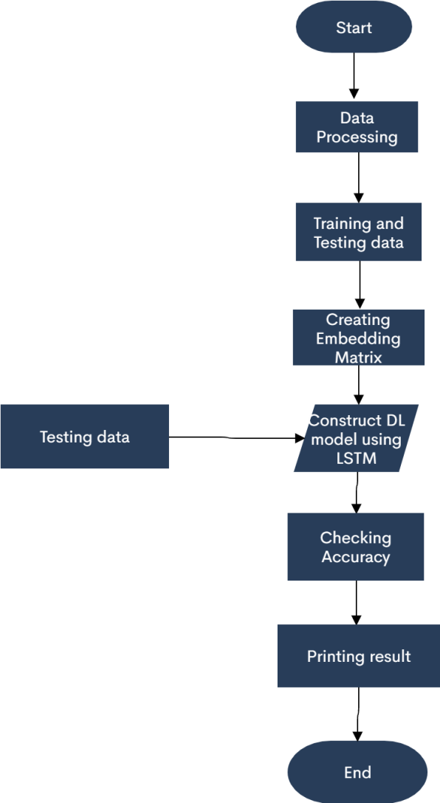
Flowchart

Slide 14
Learning Outcomes
Selection of suitable dataset.
Techniques of data pre-processing.
Various methods of data visualisation.
Various libraries of python.

Slide 15
References
https://deepmoji.mit.edu/
https://towardsdatascience.com/data-visualization-using-matplotlib-16f1aae5ce70
https://www.learndatasci.com/tutorials/python-pandas-tutorial-complete-introduction-for-beginners/
https://www.udemy.com/course/machinelearning/
https://www.youtube.com/watch?v=iMIWee_PXl8&list=RDCMUCwB7HrnRlOfasrbCJoiZ9Lg&index=23&ab_channel=TheSemicolon
https://towardsdatascience.com/machine-learning-recurrent-neural-networks-and-long-short-term-memory-lstm-python-keras-example-86001ceaaebc

Slide 16
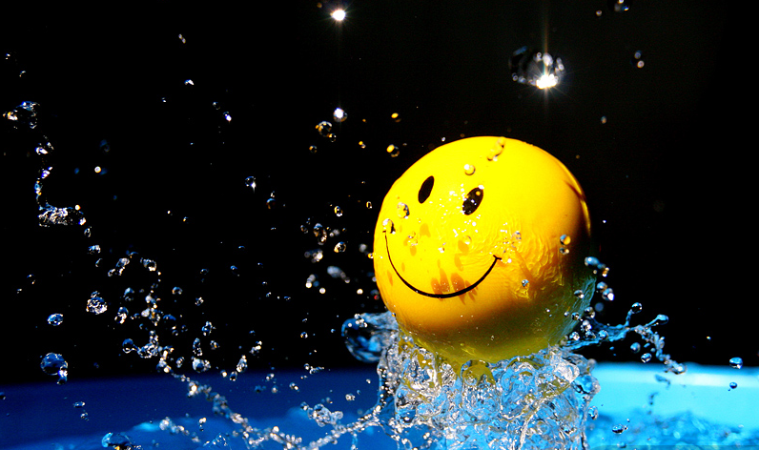
THANK YOU!!

